Slide 1
Prom Pie2Face
A presentation by
Kurt Burgess and Hadyn Jeffery

Slide 2
What we are doing:
We would like to hold an event where students pay to pie a teacher in the face.
This will help us raise money for the Year 11 prom , but also allow students to get revenge on the teachers.

Slide 3
Why are we doing this?
We are doing this to give Year 11’s the Prom they deserve.
To give all students a foundation when it comes to raising money for their Prom in years to come!

Slide 4
Cost
Students will pay £1 to throw a pie at a teacher.
They then can have their picture taken with the teacher (covered in Pie) for an extra £1.

Slide 5
Where and when?
We would like to hold this on a Wednesday P5.
This would take place outside in the court yard.
All PL groups whose teachers are involved can get our sponsor form to raise money for the whole PL group to Pie their PL Tutor.

Slide 6
Why is this a successful idea?
This idea we believe will be popular and appealing to students, and will raise substantial funds for the school Prom.

Slide 7
Expected Profits
We have asked 39 teachers.
There are over 700 students in the school.
Going by how many students paid in other activities around the school, we estimate that there will be approximately £150 made per 5 teachers. And with the photo costing only an extra £1 we could expect at least a third of the participants to want a picture giving us an extra £50.

Slide 8
Teachers Involved:
Mrs Simm
Mr GB
Mrs Baldwin
Mr Sorrento
Mr Robinson
Miss Tedstone
Mr Cole
Mr Bridges
Mrs Smith
Mr Smith
Mrs Ermini
With more on the way!!!

Slide 9
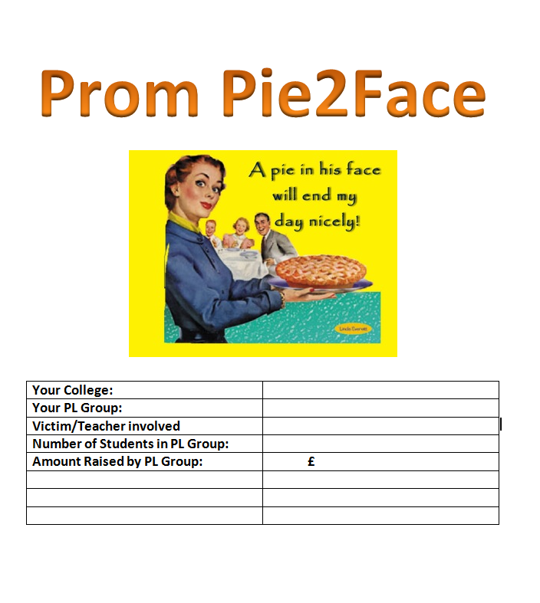
Sponsor Form

Slide 10
Thanks for your time, See you there!

